Slide 1
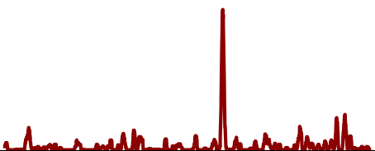
Pertussis resurgence in societies with high vaccination coverage
Hannah Niese, Markus Niese, Timo Schönegg
Pertussis resurgence

Slide 2
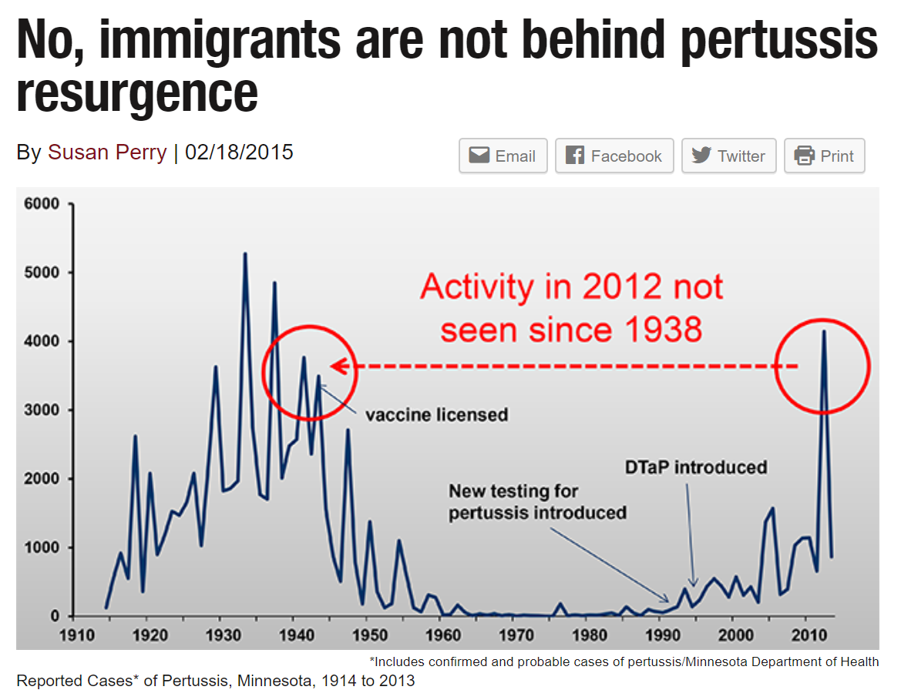
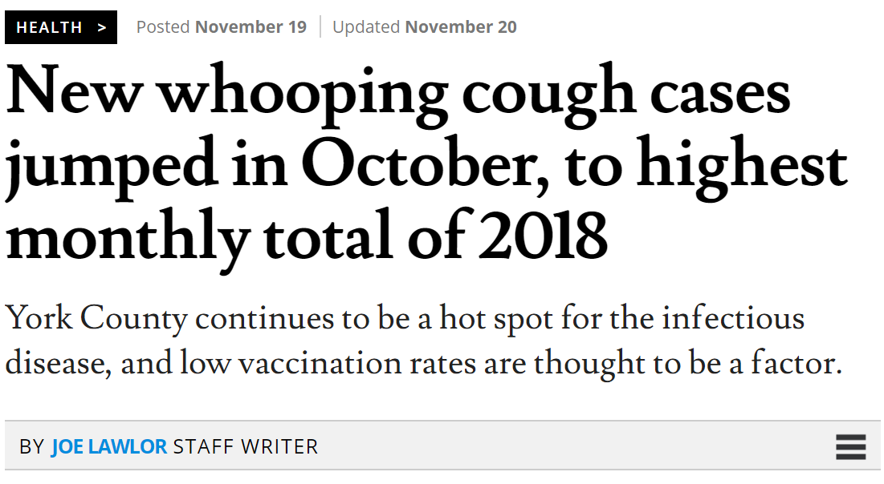
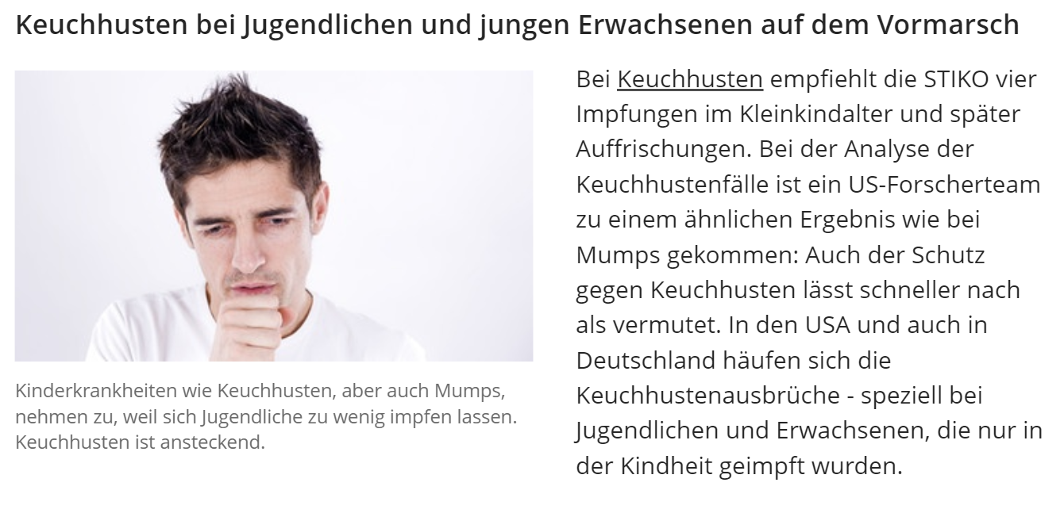
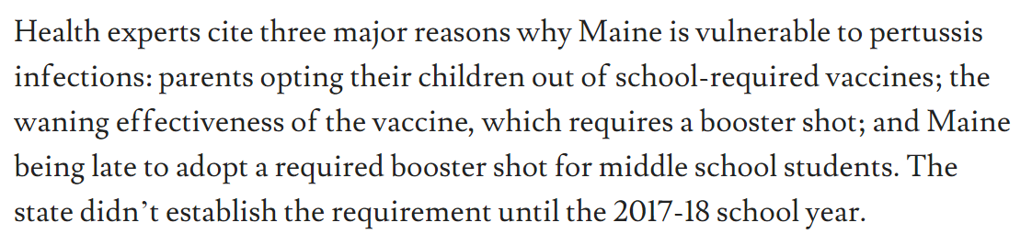
Recent cases
Pertussis resurgence

Slide 3
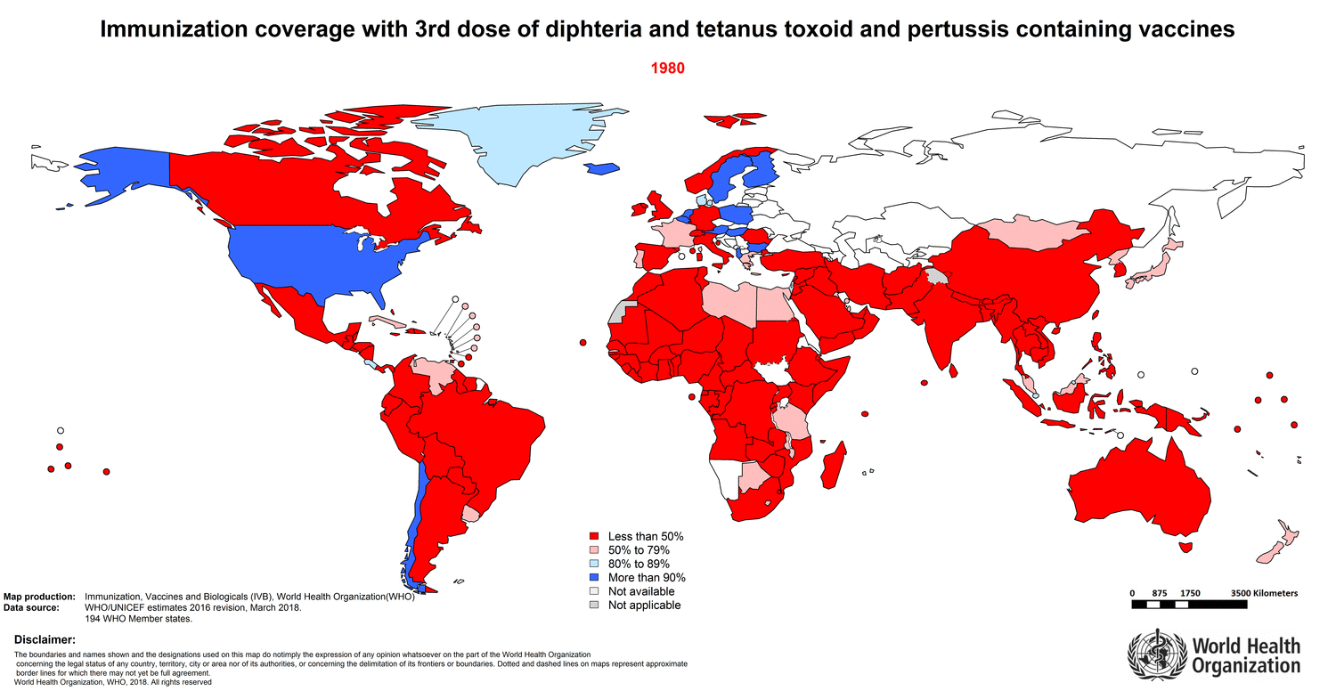
Pertussis resurgence

Slide 4
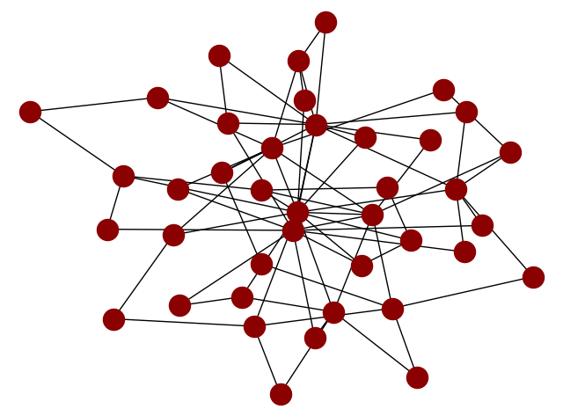
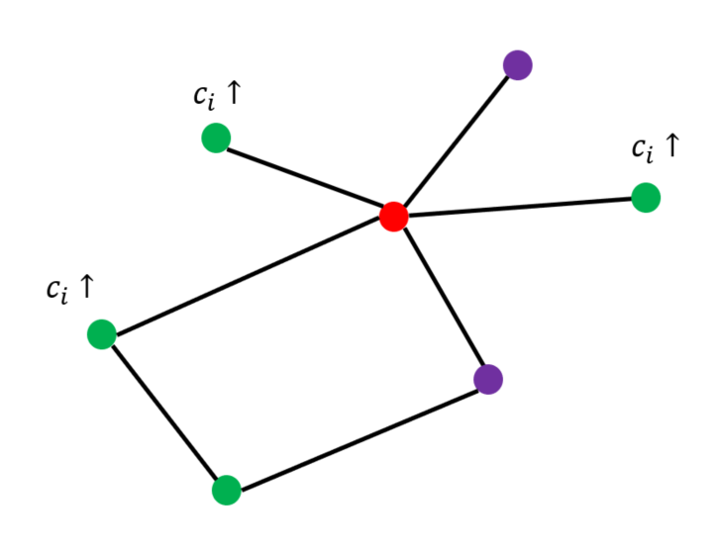
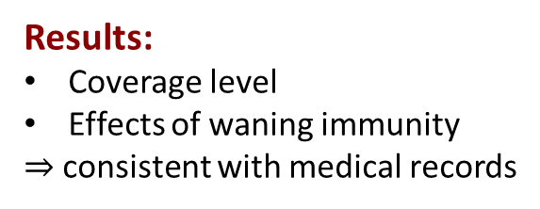

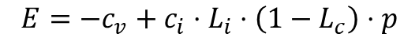
SIR Model
Vaccination Decision
Network
Pertussis
Human-to-human infection
Incubation (7-14 days)
Duration (6 weeks)
Probability of infection 0.5
Immunity
100% protection
Waning immunity: 12 years (std. dev. 2 years)
Cost function
Perceived cost of vaccination
Perceived cost of infection
Barabási-Albert Network
$$E=−c_{v}+c_{i}⋅L_{i}⋅\left(1−L_{c}\right)⋅p$$
Results:
Coverage level
Effects of waning immunity
$⇒$consistent with medical records
Could be used for:
Policy Analysis
Design vaccination programmes
$⇒$better specification needed
Pertussis resurgence

Slide 5
Infection
Pertussis resurgence
⬛ Healthy
⬛ Recently infected
⬛ Vaccinated

Slide 6
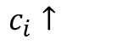
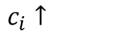
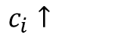
Infection
$c_{i}↑$
$c_{i}↑$
$c_{i}↑$
Pertussis resurgence
⬛ Healthy
⬛ Recently infected
⬛ Vaccinated

Slide 7
Infection
Pertussis resurgence
⬛ Healthy
⬛ Recently infected
⬛ Vaccinated

Slide 8
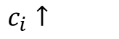
Infection
$c_{i}↑$
Pertussis resurgence
⬛ Healthy
⬛ Recently infected
⬛ Vaccinated

Slide 9
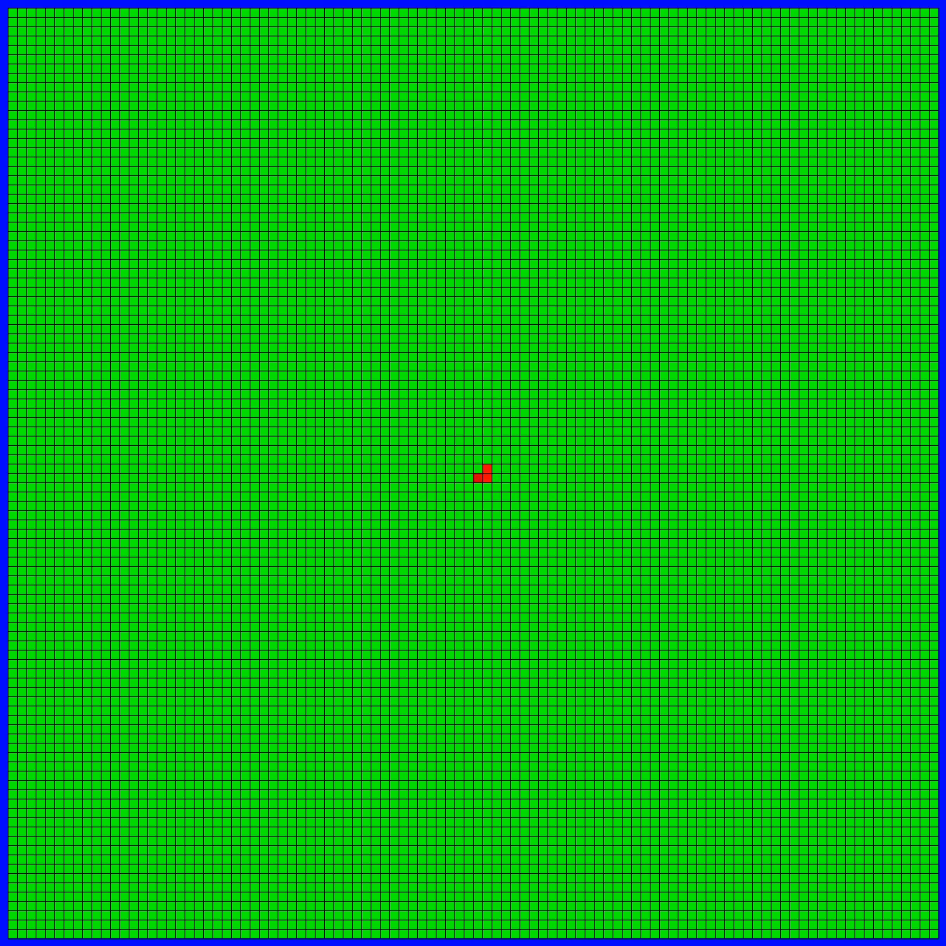
Visualisation on a Grid
Population: 10,000
⬛ Healthy
⬛ Recently infected
⬛ Infected, but not contagious
⬛ Immune
⬛ Vaccinated
Pertussis resurgence
Pertussis resurgence

Slide 10
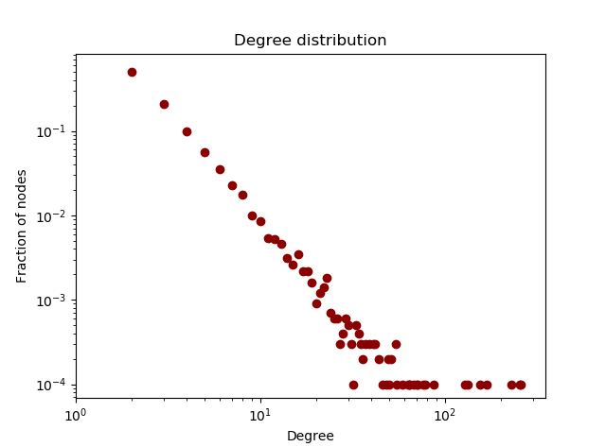
Network structure
10,000 nodes
Pertussis resurgence

Slide 11
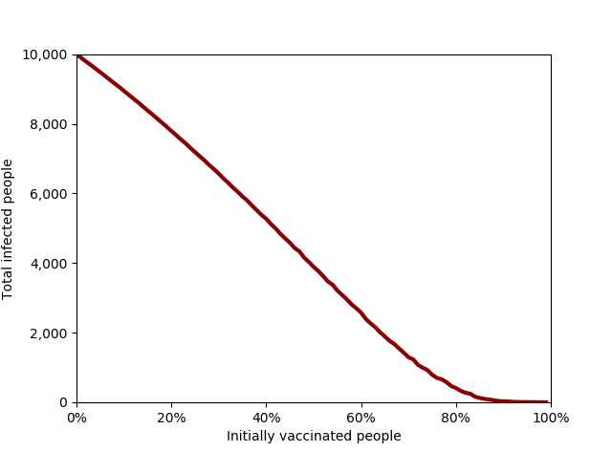
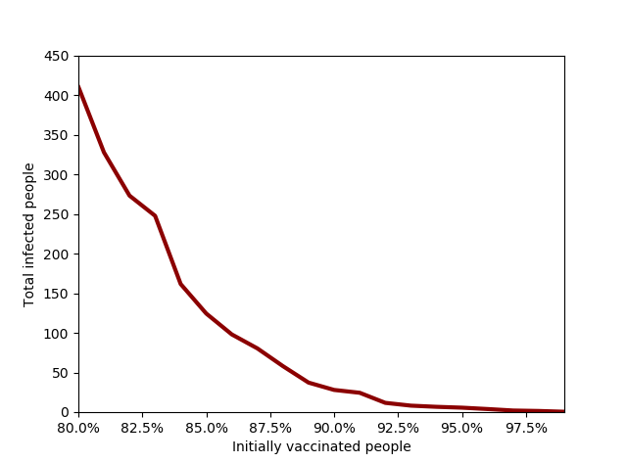
Short term analysis
Determining vaccination coverage rates
Population: 10,000
Number of people who were infected during the first 500 days of the outbreak
Pertussis resurgence
Pertussis resurgence

Slide 12
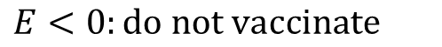
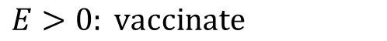
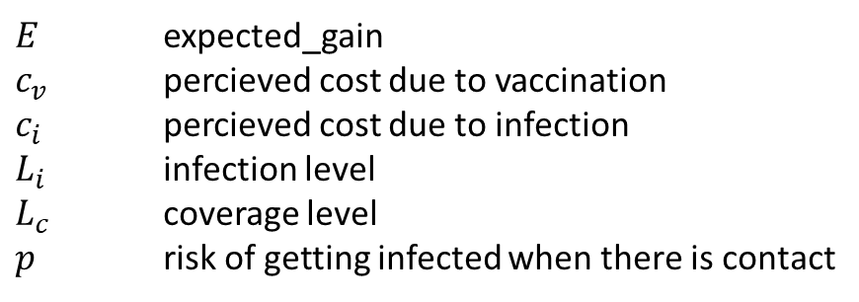
Cost function and initial conditions
$$E=−c_{v}+c_{i}⋅L_{i}⋅\left(1−L_{c}\right)⋅p$$
$E$ expected_gain
$c_{v}$ percieved cost due to vaccination
$c_{i}$ percieved cost due to infection
$L_{i}$ infection level
$L_{c}$ coverage level
$p$ risk of getting infected when there is contact
$$E>0: vaccinate$$
$$E<0:do not vaccinate$$
Pertussis resurgence
Bauch & Earn (2004). Vaccination and the theory of games

Slide 13
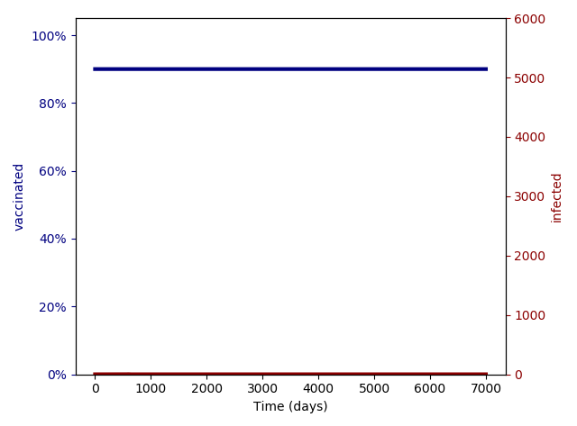
Vaccination scares
Pertussis resurgence

Slide 14
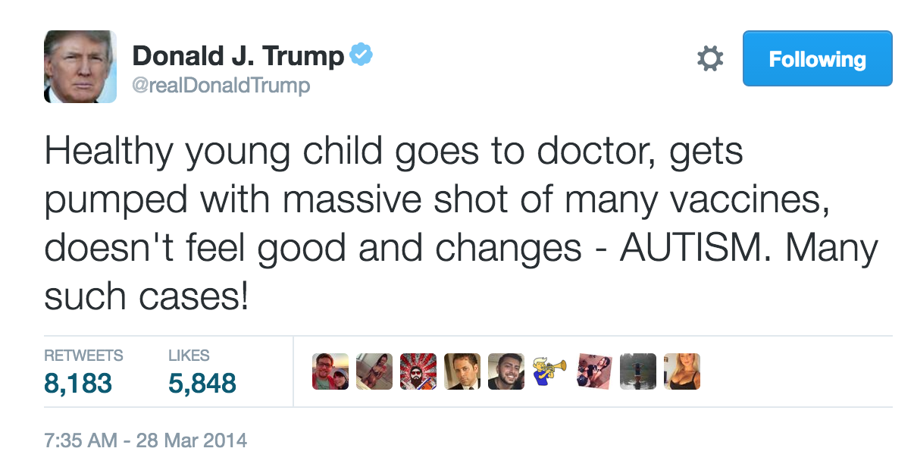
Vaccination scares
Pertussis resurgence

Slide 15
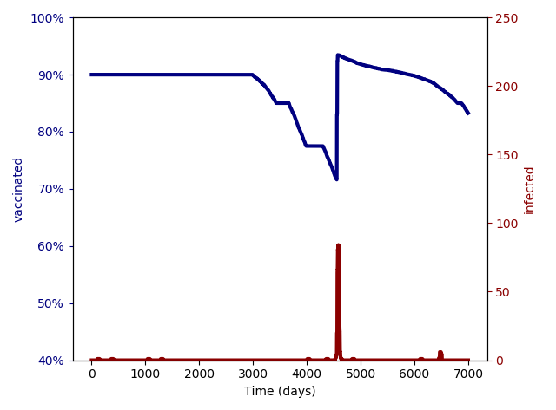
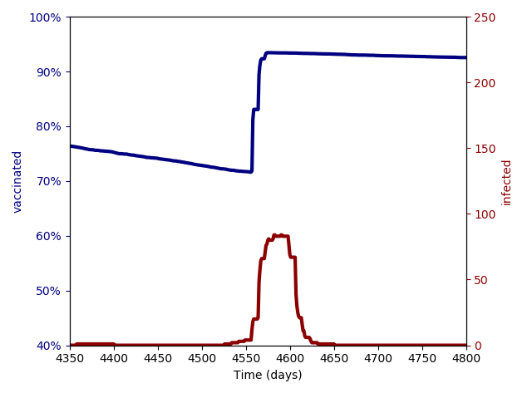
Long term analysis
Population: 10,000
Pertussis resurgence
Pertussis resurgence

Slide 16
Summary
92%
Pertussis resurgence

Slide 17
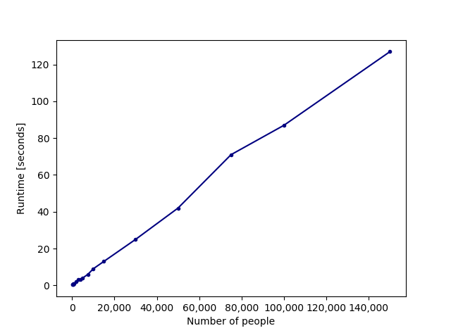
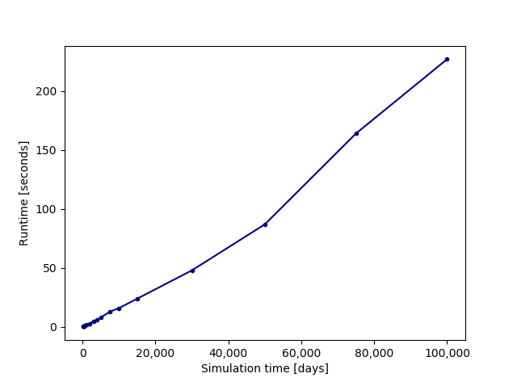
Additional graphs: runtime
Pertussis resurgence

Slide 18
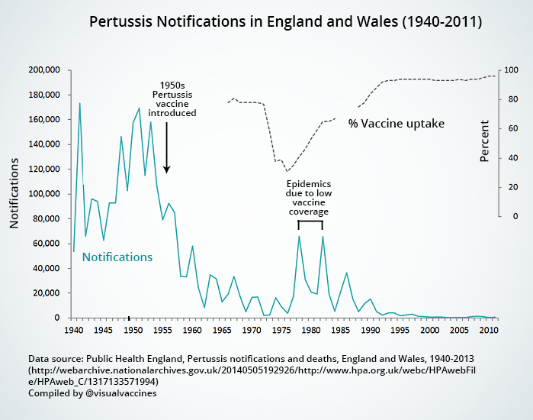
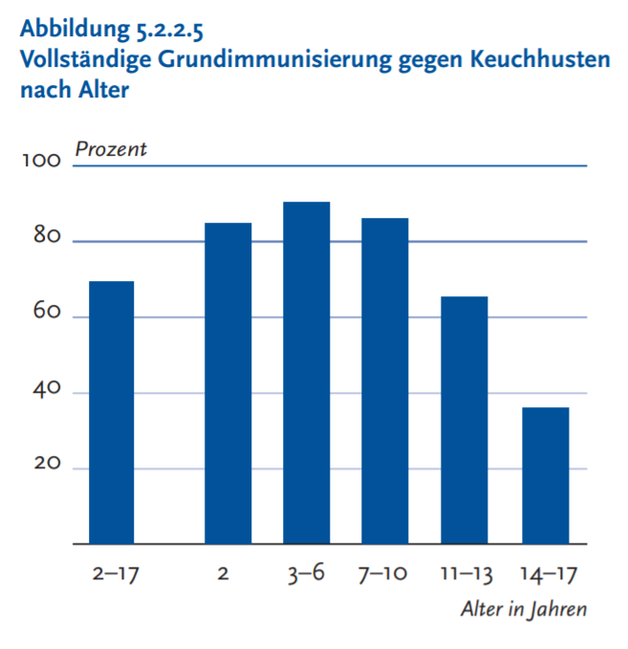
Additional graphs: real data
Pertussis resurgence

Slide 19
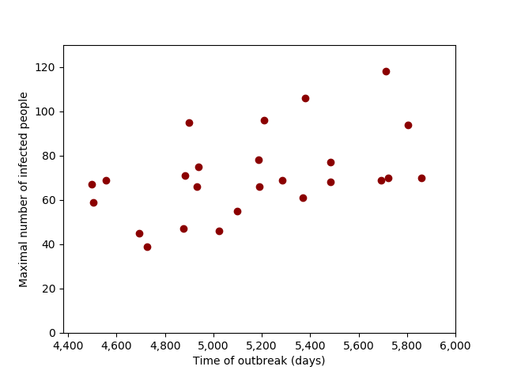
Additional graphs: vaccination scares
Pertussis resurgence

